Slide 1
Project Title
Under Ground Cable Fault Detection Using Arduino
Under the Guidance of
Prof Atul Kumar Choudhary
Submitted by
Kumar Tanmay Anand
Amisha Raj
Nishikant Kumar
Sneha Deep
Gaurav Kumar

Slide 2
ABSTRACT
The objective of this project is to determine the distance of underground cable fault from base station in kilometers using an Arduino board.
While a fault occurs for some reason, at that time the repairing process related to that particular cable is difficult due to not knowing the exact location of the cable fault.
The project uses the standard concept of Ohms law i.e., when a low DC voltage is applied at the feeder end through a series resistor (Cable lines), then current would vary depending upon the location of fault in the cable.

Slide 3
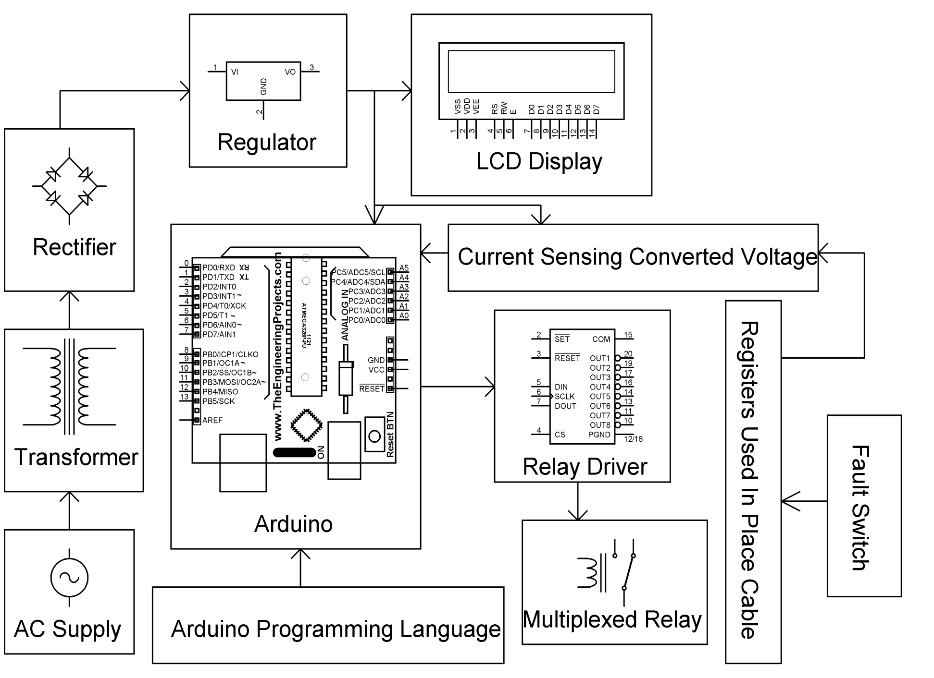
BLOCK DIAGRAM

Slide 4
HARDWARE REQUIREMENTS
Arduino Duemalinove
Transformer
Voltage Regulator, Crystal.
Relay Driver IC, Relay, Diodes, Resistors, Capacitors, Push Button.
LCD Display

Slide 5
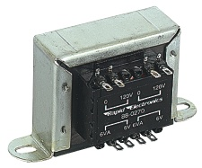
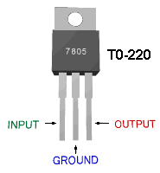
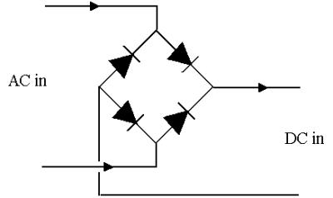
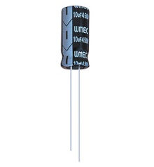
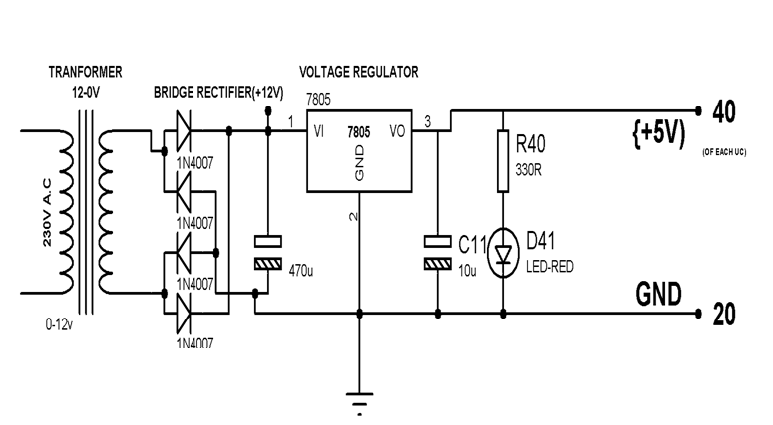
POWER SUPPLY
230 V AC
50 Hz
Bridge rectifier
5v Regulator
5V DC
12V step down
transformer
Filter(470µf)

Slide 6
ARDUINO
The Arduino microcontroller is an easy to use yet powerful single board computer that has gained considerable traction in the hobby and professional market.
The Arduino is open-source, which means hardware is reasonably priced and development software is free.

Slide 7
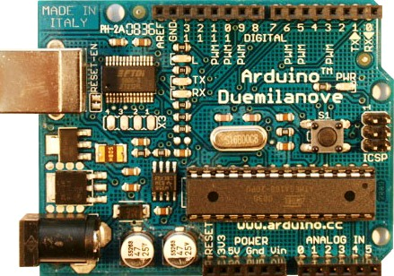
IMAGE OF DEVELOPMENT BOARD

Slide 8
FEATURES OF DUEMALINOVE
The Duemalinove board features an Atmel ATmega328 microcontroller operating at 5 V with 2 Kb of RAM, 32 Kb of flash memory for storing programs and 1 Kb of EEPROM for storing parameters.
The clock speed is 16 MHz, which translates to about executing about 300,000 lines of C source code per second

Slide 9
…..contd
The Arduino programming language is a simplified version of C/C++. If you know C, programming the Arduino will be familiar.
If you do not know C, no need to worry as only a few commands are needed to perform useful functions.

Slide 10
WHAT IS CALLED ANDROID..?
Android is an open-source operating system which means that any manufacturer can use it in their phones free of charge.
It was built to be truly open. For example, an application can call upon any of the phone’s core functionality such as making calls, sending text messages, or using the camera.

Slide 11
…….contd
Android is built on the open Linux Kernel. Furthermore, it utilizes a custom virtual machine that was designed to optimize memory and hardware resources in a mobile environment.

Slide 12
RESISTORS
A resistor is a two-terminal electronic component designed to oppose an electric current by producing a voltage drop between its terminals in proportion to the current, that is, in accordance with Ohm's law:
V = IR
Resistors are used as part of electrical networks and electronic circuits.
They are extremely commonplace in most electronic equipment. Practical resistors can be made of various compounds and films, as well as resistance wire (wire made of a high-resistivity alloy, such as nickel/chrome).

Slide 13
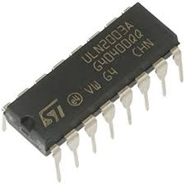
RELAY DRIVER
Relay Driver IC. A Relay driver IC is an electro-magnetic switch that will be used whenever we want to use a low voltage circuit to switch a light bulb ON and OFF which is connected to 220V mains supply.
The ULN2003A is an array of seven NPN Darlington transistors capable of 500 mA, 50 V output.

Slide 14
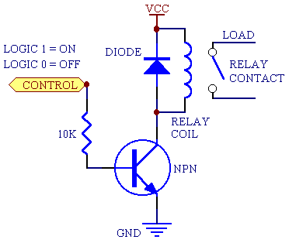
RELAY
It is a electro magnetic switch
Used to control the electrical devices
Copper core magnetic flux plays main role here

Slide 15

The relay's switch connections are usually labeled COM, NC and NO:
COM = Common, always connect to this; it is the moving part of the itch.
NC = Normally Closed, COM is connected to this when the relay coil is off.
NO = Normally Open, COM is connected to this when the relay coil is on

Slide 16
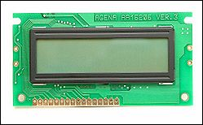
LIQUID CRYSTAL DISPLAY (LCD)
Most common LCDs connected to the microcontrollers are 16x2 and 20x2 displays.
This means 16 characters per line by 2 lines and 20 characters per line by 2 lines, respectively.
The standard is referred to as HD44780U, which refers to the controller chip which receives data from an external source (and communicates directly with the LCD.

Slide 17
WORKING
Resistance is directly proportional to length.
Length resistance convert in voltage using differential amplifier.
Read the voltage using analog pin of Arduino.
Arduino convert voltage in length and display on LCD.

Slide 18
SOFTWARE REQUIREMENTS
Arduino software which can be freely available on Arduino Forum
http://arduino.cc/en/Guide/HomePage.

Slide 19
ADVANTAGES
Arduino open hardware-simplest programming language
Cost of finding location of the fault reduces
Complexity in finding the fault reduces
Disadvantages
Showing limited distance on kit
showing the faults at the 1KM radius

Slide 20
BIBILOGRAPHY
www.atmel.com
www.beyondlogic.org
www.wikipedia.org
www.howstuffworks.com
www.alldatasheets.com

Slide 21
THANK YOU

